Slide 1
Developing the Overall Audit Plan and Audit Program
Chapter 13

Slide 2
Learning Objective 1
Use the five types of audit tests to determine whether financial statements are fairly stated.

Slide 3

Types of Tests
Risk assessment procedures
Further audit procedures
Notes:
The second standard of fieldwork requires the auditor to obtain an understanding of the entity and its environment.
Risk assessment procedures are performed to assess the risk of material misstatement in the financial statements.

Slide 4
Further Audit Procedures and the Audit Risk Model
Audit risk
model
AAR
IR × CR
= PDR
Tests of
controls
+
Substantive
tests of
transactions
+
Analytical
procedures
+
Tests of
details of
balances
=
Sufficient
appropriate
evidence
per GASS
Further audit procedures
Notes:
Tests of controls may include inquiries of appropriate client personnel, the examination of documents, observation of control-related activities and the reperformance of client procedures.
Substantive tests are procedures designed to test for dollar misstatements that directly affect the correctness of financial statement balances.
Substantive tests of transactions are used to determine whether all six transaction-related audit objectives have been satisfied for each class of transactions.
Analytical procedures involve comparisons of recorded amounts to expectations developed by the auditor.
Tests of details of balances focus on the ending general ledger balances for both balance sheet and income statement accounts.

Slide 5

Risk Assessment Procedures
A major part of these procedures are
done to obtain an understanding
of internal control.

Slide 6
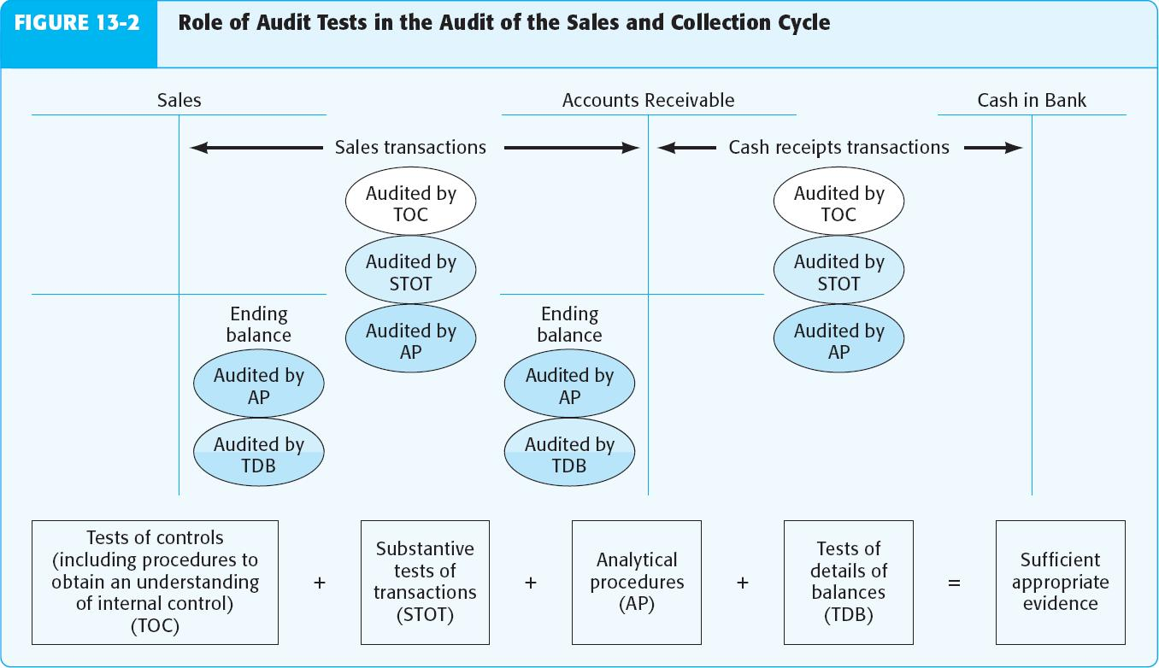
Role of All Audit Tests in the Sales and Collection Cycle

Slide 7
Learning Objective 2
Select the appropriate types of audit tests.

Slide 8
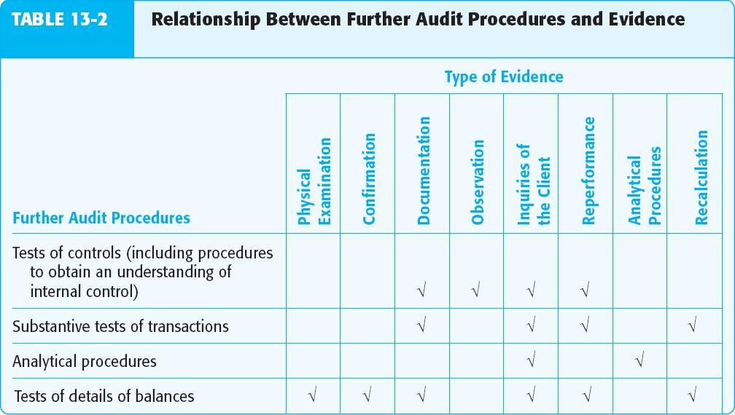
Relationship Between Further Audit Procedures and Evidence
Notes:
Tests of controls help auditors evaluate whether controls over transactions in the cycle are sufficiently effective to support the reduced assessment of control risk and thereby allow reduced substantive testing.
Tests of controls also form the basis for the auditor’s report on internal control over financial reporting for larger public companies.
By combining the types of audit tests shown above, the auditor obtains a higher overall assurance for transactions and accounts in the sales and collection cycle than assurance obtained from any one test.

Slide 9
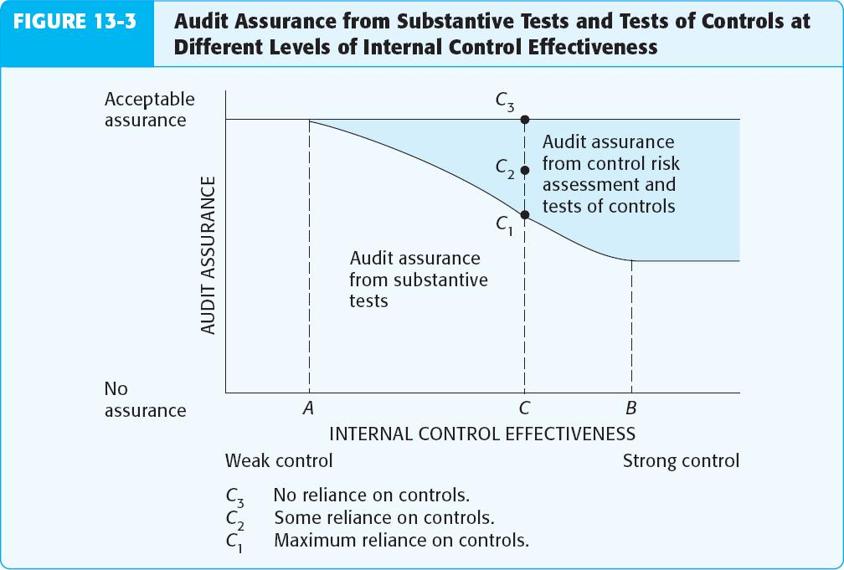
Audit Assurance at Different Levels of Internal Control Effectiveness
Notes:
There is a trade-off between tests of controls and substantive tests. If tests of controls support the control risk assessment, planned detection risk in the audit risk model is increased and planned substantive tests can therefore be reduced.

Slide 10
Learning Objective 3
Understand how information technology affects audit testing.

Slide 11

Impact of Information Technology on Audit Testing
SAS 80 (AU 326) and SAS 109 (AU 319)
provide guidance for auditors of entities
that transmit, process, maintain, or access
significant information electronically.
Notes:
Because of the inherent consistency of IT processing, the auditor may be able to reduce the extent of testing of an automated control.

Slide 12
Impact of Information Technology on Audit Testing
Computer-assisted audit techniques may be
used to test automated controls or data.
Reports produced by IT may be used to test
the effectiveness of IT general controls.
Program change controls
Access controls

Slide 13
Learning Objective 4
Understand the concept of evidence mix and how it should be varied in different circumstances.

Slide 14
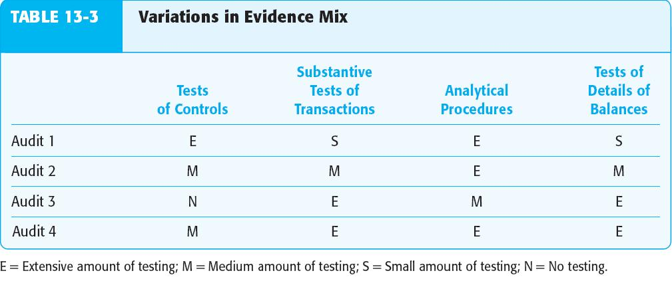
Variations in Evidence Mix
Notes:
The choice of which tests to use and how extensively they need to be performed can vary widely among audits for differing levels of internal control effectiveness and inherent risks.
Client 1 is a large company with sophisticated internal controls and low inherent risk.
Client 2 is medium sized with some controls and a few inherent risks.
Client 3 is medium sized but has few effective controls and significant inherent risks.
Client 4 is a situation where the original plan was to follow the approach used in client 2; however, the auditor found extensive control test deviations and significant misstatements while performing substantive tests of transactions and controls were not effective.

Slide 15
Learning Objective 5
Design an audit program.

Slide 16



Audit Program
Part 1:
Tests of controls and substantive
tests of transactions
Part 2:
Analytical procedures
Part 3:
Tests of details and balances
Notes:
The program is designed to satisfy transaction-related and balance-related objectives.
Each transaction cycle will likely be evaluated using a separate set of sub-audit programs.

Slide 17
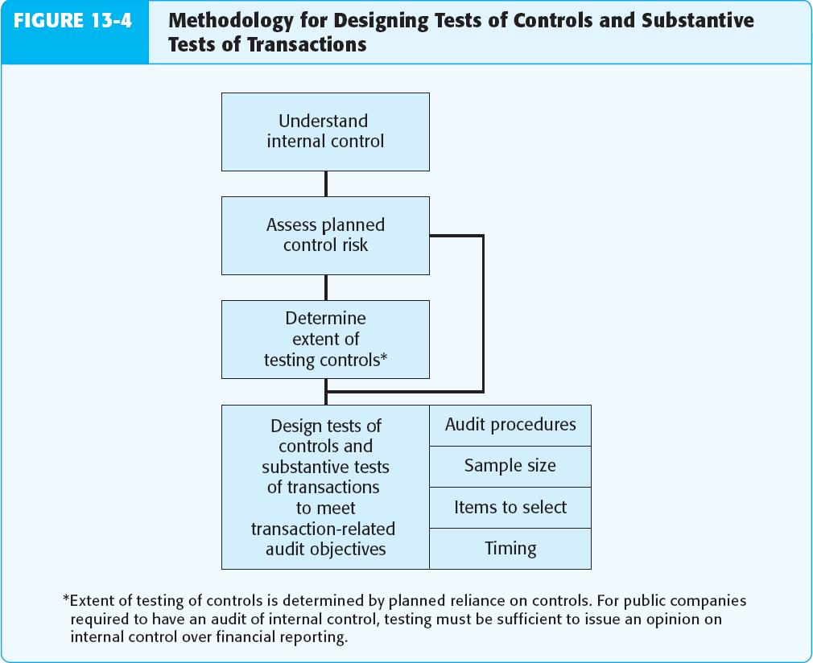
Methodology for Designing Controls and Substantive Tests

Slide 18
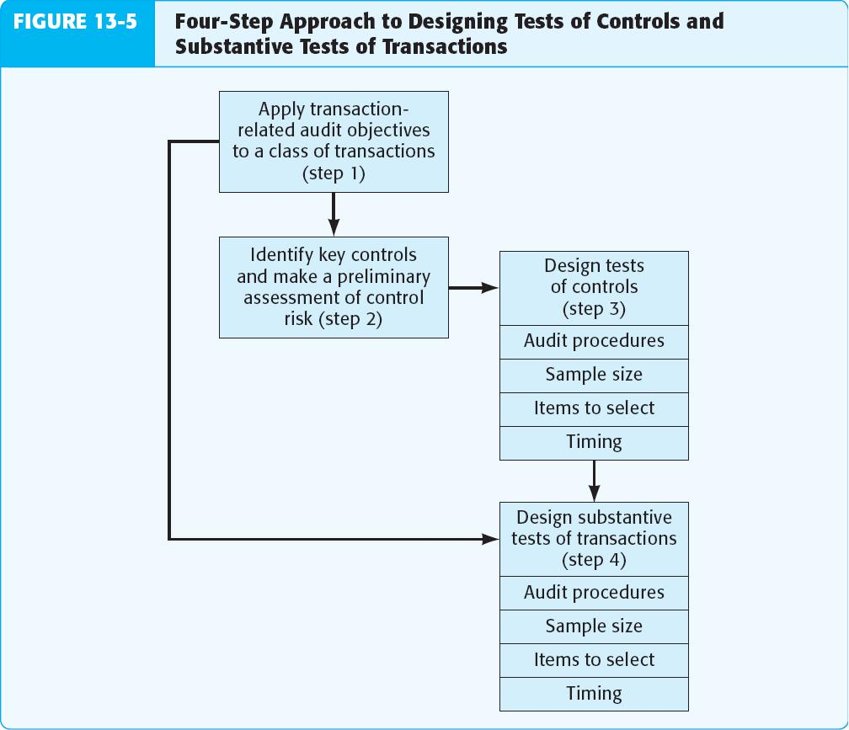
Four-Step Approach to Designing Control and Substantive Tests
Notes:
Four-step approach to reduce control risk by designing control and substantive tests:
1. Apply the transaction-related audit objectives to the class of transactions being tested.
2. Identify key controls that should reduce control risk for each audit objective.
3. Develop appropriate tests of controls.
4. Design substantive tests of transactions.

Slide 19
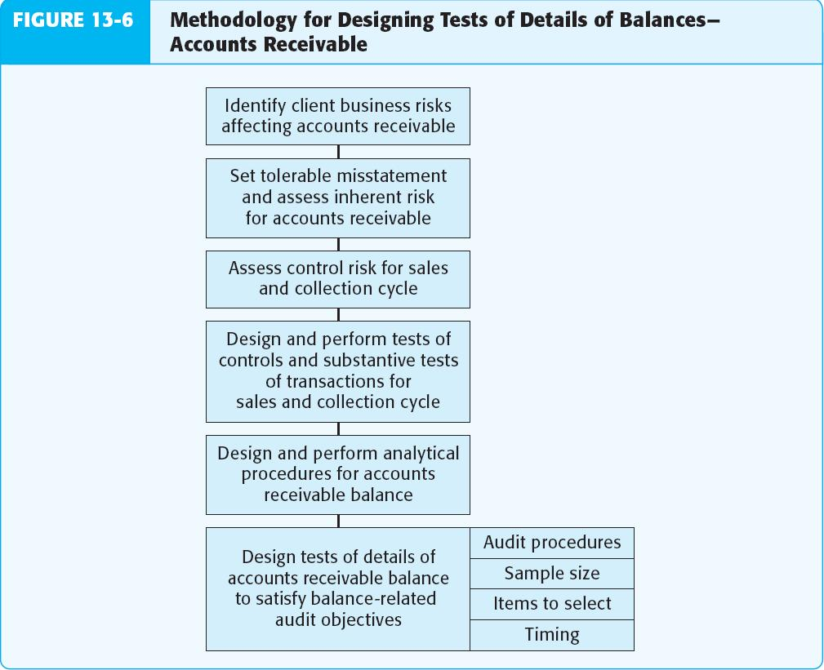
Methodology for Designing Tests of Balances – Accounts Receivable
Notes:
As part of gaining an understanding of the client’s business and industry, the auditor identifies and evaluates significant client business risks to determine whether they result in increased risk of material misstatements in the financial statements. These risks will then affect the appropriate extent of evidence.
Auditors must decide the preliminary judgment about materiality for the audit as a whole and then allocate the total to account balances, to establish the tolerable misstatement for each significant balance.
Effective controls will reduce control risk and the amount of evidence required for substantive tests of transactions and tests of details of
balances. Ineffective controls will increase the evidence needed.
The auditor usually plans to do extensive tests of controls when control risk is assessed as low. This will permit less extensive substantive testing of accounts receivable balances.
Auditors perform substantive analytical procedures for accounts receivable to identify possible misstatements in the account balance and to reduced detailed audit tests.
A difficulty auditors face in designing tests of details of balances is the need to predict the outcome of the tests of controls substantive tests of transactions and substantive analytical procedures before they are performed.

Slide 20
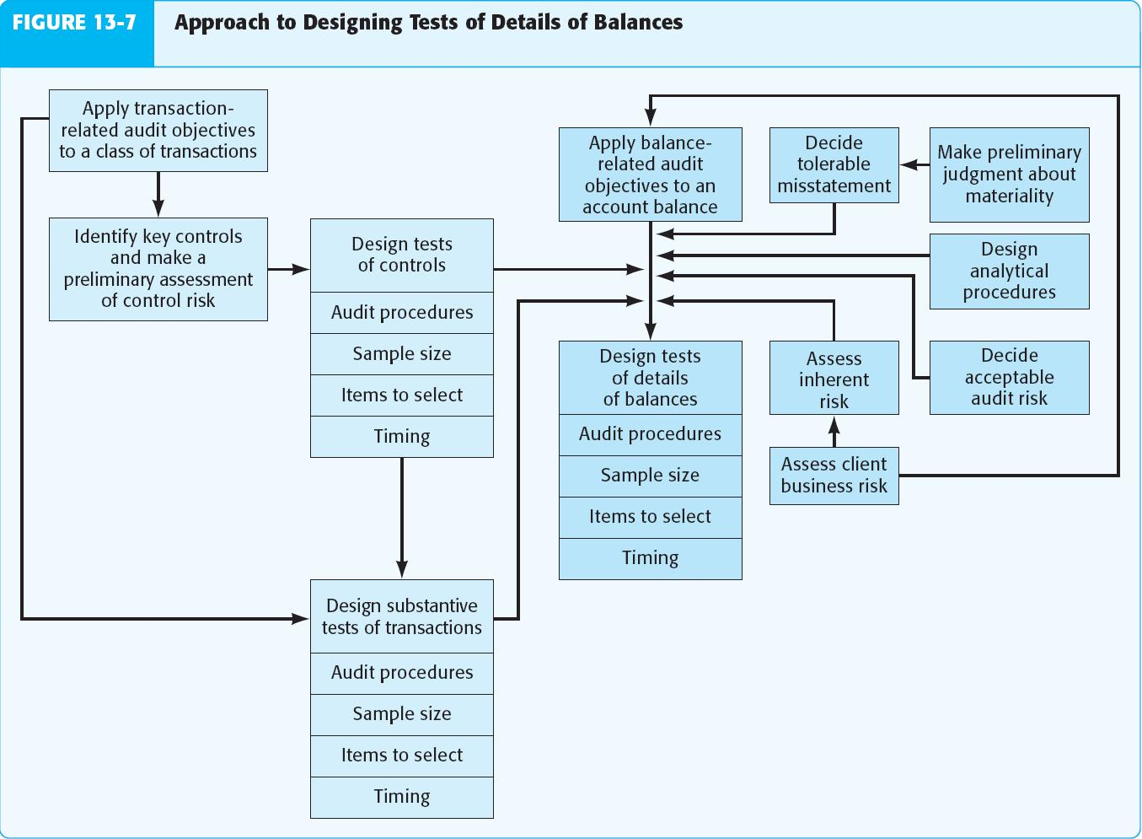
Methodology for Designing Tests of Balances – Accounts Receivable
Notes:
One of the most challenging parts of auditing is properly applying the factors that affect tests of details of balances. Each of the factors is subjective.
The various planning activities we discussed in chapters 6 through 13 are applied at different levels of disaggregation.

Slide 21
Learning Objective 6
Compare and contrast transaction-related audit objectives with balance-related and presentation and disclosure-related audit objectives.

Slide 22
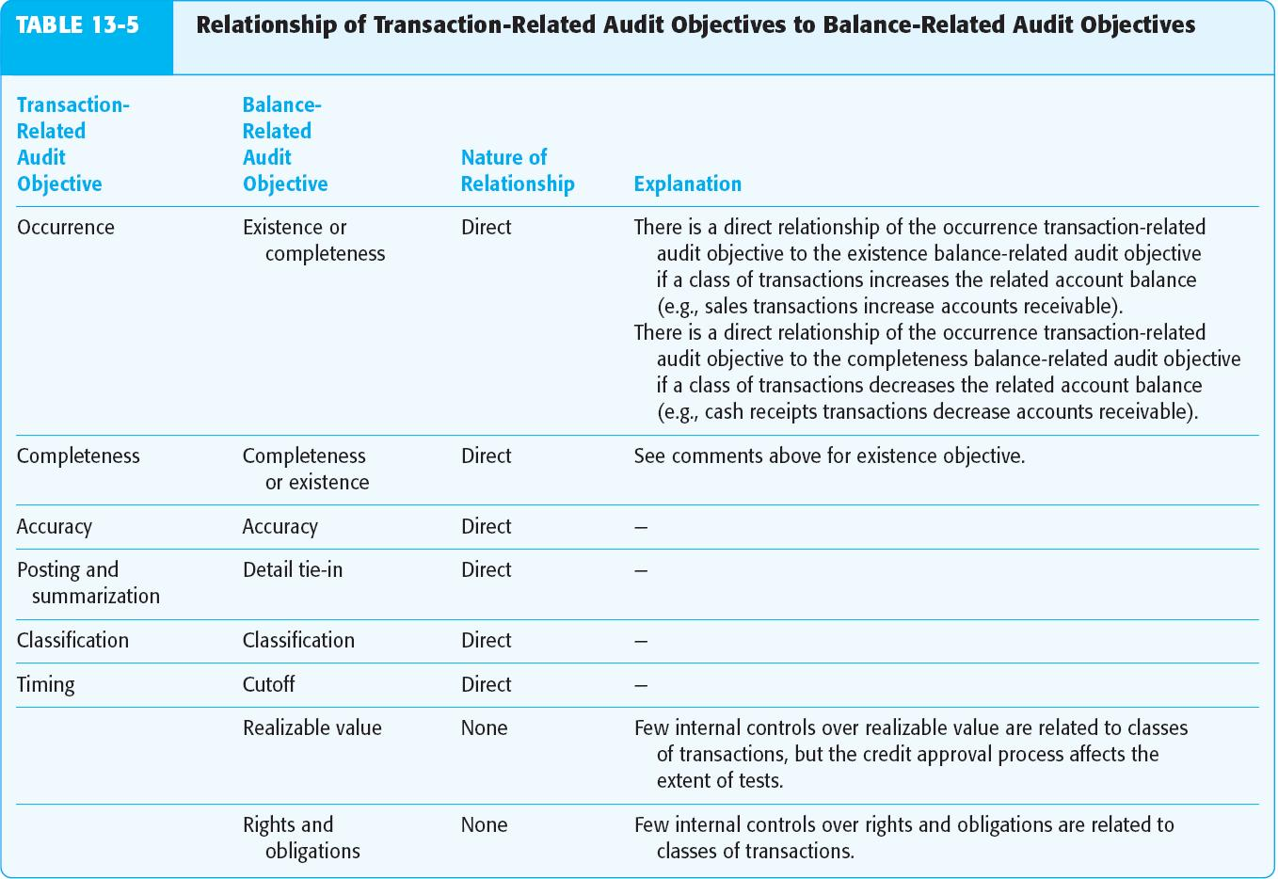
Relationship of Transaction-related Audit Objectives to Balance-related Audit Objectives
Transaction-
related
Audit
Objective
Balance-
related
Audit
Objective
Nature of
Relationship
Occurrence
Completeness
Accuracy
Posting and
summarization
Classification
Timing
Existence or completeness
Completeness or existence
Accuracy
Detail tie-in
Classification
Cutoff
Realizable value
Rights and obligation
Direct
Direct
Direct
Direct
Direct
Direct
None
None

Slide 23
Relationship Among Five Key Evidence-related Terms
Phases of the audit process
Audit objectives
Types of tests
Evidence decisions
Types of evidence

Slide 24

Phases of the Audit Process
Plan and design an audit approach.
Perform tests of controls and
substantive tests of transactions.
Perform analytical procedures and
tests of details of balances.
Complete the audit and issue an
audit report.

Slide 25

Audit Objectives
Transaction-related
Balance-related
Presentation and disclosure-related

Slide 26

Types of Tests
Risk assessment procedures
Tests of controls
Substantive tests of transactions
Analytical procedures
Tests of details of balances

Slide 27

Evidence Decisions
Audit procedures
Sample size
Items to select
Timing

Slide 28


Types of Evidence
Documentation
Inquiries of Client
Physical
Evidence
Audit
Evidence
Confirmation
Recalculation
Analytical
Procedures
Reperformance
Observation

Slide 29
Learning Objective 7
Integrate the four phases of the audit process.

Slide 30
Summary of the Audit Process
Phase I
Plan and design
an audit approach
Phase III
Perform analytical
procedures and
tests of details
of balances
Phase II
Perform tests of
controls and
substantive tests
of transactions
Phase IV
Complete the
audit and issue
an audit report

Slide 31
Summary of the Audit Process: Phase I
Accept client and perform initial planning
Understand the client’s business and industry
Assess client’s business risk
Perform preliminary analytical procedures
Notes:
Auditors use information obtained from risk assessment procedures related to client acceptance and initial planning to assess inherent risk and acceptable audit risk.
Auditors use assessments of materiality, acceptable audit risk, inherent risk, control risk, and any identified fraud risks to develop an overall audit plan and audit program.

Slide 32
Summary of the Audit Process: Phase I
Set materiality and assess acceptable
audit risk and inherent risk
Understand internal control and assess control risk
Gather information to assess fraud risks
Develop overall audit plan and audit program

Slide 33
Summary of the Audit Process: Phase II
Plan to reduce assessed
level of control risk?
No
Yes
Perform tests of controls
Perform substantive tests of transactions
Assess likelihood of misstatements in
financial statements
Notes:
Objectives of phase 2 are to obtain evidence in support of the specific controls that contribute to the auditor’s assessed control risk and obtain evidence in support of the monetary correctness of transactions.

Slide 34
Summary of the Audit Process: Phase III
Low
Medium
High or
unknown
Perform analytical procedures
Perform tests of key items
Perform additional tests
of details of balances
Notes:
The two general categories of phase III procedures are:
Substantive analytical procedures that assess the overall reasonableness of transactions and balances.
Tests of details of balances, which are audit procedures to test for monetary misstatements in the balances in the financial statements.

Slide 35
Summary of the Audit Process: Phase IV
Perform additional tests for
presentation and disclosure
Accumulate final evidence
Evaluate results
Issue audit report
Communicate with audit
committee and management
Notes:
Auditors also perform substantive tests to obtain sufficient appropriate evidence that information disclosed in the footnotes reflects actual transactions and balances that have occurred and that represent obligations of the client to support the occurrence and rights and obligation objectives.

Slide 36
End of Chapter 13

